Slide 1

THE METALFORMERS GUIDE TO CONTENT STRATEGY
Notes:
[Joey]

Slide 2
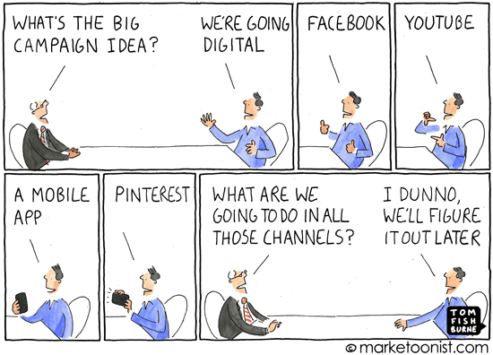
Notes:
[Rafa] This is likely a familiar scenario for many of you. Someone at your company recognizes you need to be producing content but you don’t know how or where to start. You can’t just make a company Facebook page and expect to start driving leads. You need a strategy. Today you’re going to learn how to make that strategy.

Slide 3
Customers have questions.
Notes:
[Rafa] It begins with questions. Your customers’ questions. Your customers have a business problem and they’re looking for someone to solve it. With content, you can be that someone.

Slide 4
Certifications
Notes:
[Rafa] Customers have questions about company certifications.

Slide 5
Past Projects
Notes:
[Rafa] Maybe they have a specific problem and they want to see examples of how other companies have solved it.

Slide 6
Technical Specifications
Notes:
[Rafa] They want to see technical specifications. Product data sheets and part dimensions.

Slide 7
Equipment List
Notes:
[Rafa] They want to know your capabilities or find a supplier that has a certain piece of equipment.

Slide 8
How To Guides
Notes:
[Rafa] They want to see how-to guides that show them how to solve their problems.

Slide 9
Supply Chain Solutions
Notes:
[Rafa] They want to know solutions to supply chain issues like product availability or lowering cost per part.

Slide 10
Reducing Defective Parts
Notes:
[Rafa] They want to know how to reduce the number of defective parts.

Slide 11
Customers want answers.
Notes:
[Rafa] They’re asking these questions with the expectation that a subject matter expert can answer them.

Slide 12
They want content.
Notes:
[Rafa] With content, you can become that subject matter expert.

Slide 13
Why Content?
90% of consumers find custom content useful
78% believe organizations that provide custom content are interested in building good relationships with them
61% of people feel better about a company that delivers custom content and are more likely to buy from that company
77% of people understand that an organization’s goal for custom content is to sell them something, but are OK with it as long as it provides value
Notes:
[Joey]

Slide 14
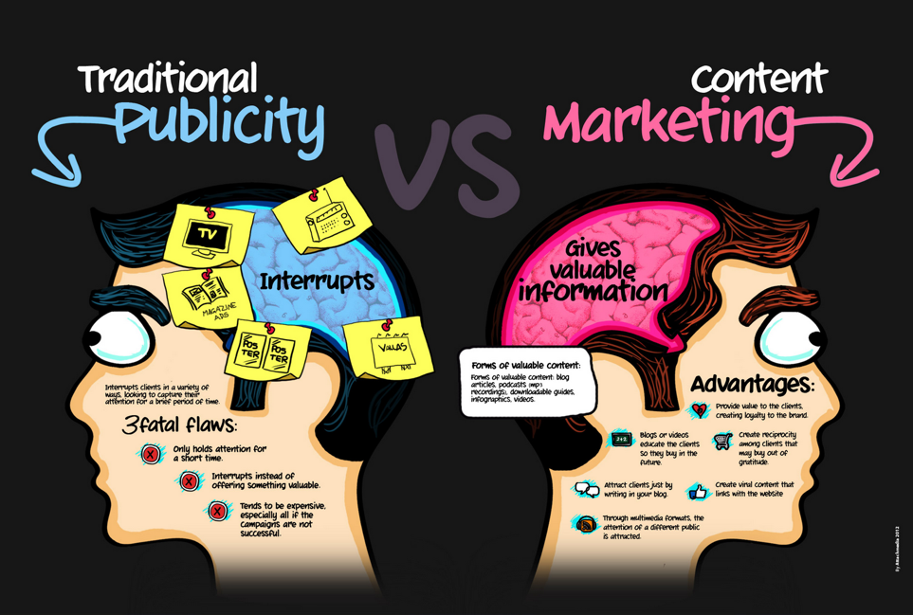
Notes:
[Rafa & Joey] Before we get into the how, let’s talk about the why. What is content marketing and how is it different from traditional marketing? Traditional marketing interrupts. You’re in the middle of watching a football game, then bam, an advertisement. You didn’t ask for this advertisement. This advertisement is not helping you or adding to the experience. It’s interrupting you. Even online, you get junk mail and pop-ups ads everyday. This interruptive model doesn’t work because 96% of the time, customers are not ready to buy.
That’s because everyone moves through the buying process at different speeds. At some point in that buying process, most customers go online to educate themselves on how to solve problems. With content marketing, you’re the educator. You’re providing the white paper or video that funnels the customer to the next step in the buying process. You didn’t interrupt the customer. You didn’t cold call them. They came to you. You gave them content and built their trust.

Slide 15
Not here to sell. Here to tell.
Notes:
[Rafa] We’re not here to sell you on content marketing. You’re sitting here because you’re aware of the value of producing content. We’re here to tell you how.

Slide 16
Joey and Rafael
Notes:
[Joey & Rafa] I’m Rafael Encarnacion and I’m a User Experience Designer. My job is to make it easier for our clients’ clients to do business. I interview our client’s customers, learn what information they want and how they want it presented. Then I tap into the expertise of our client and turn that expertise into white papers, case studies, videos, and other pieces of content. For all six years of my career, I’ve focused on industrial and have written about subjects that I didn’t even know existed.

Slide 17
Agenda
Notes:
Define Content Strategy
Go Through Exercises to Define Your Customers
Types of Content
Distribution
Measure

Slide 18
Content Strategy Definition
Notes:
[Rafa] Content strategy is the creation, distribution, and measurement of content. It means making content, knowing where to send it and who to send it to, then measuring it to see if it was effective.

Slide 19
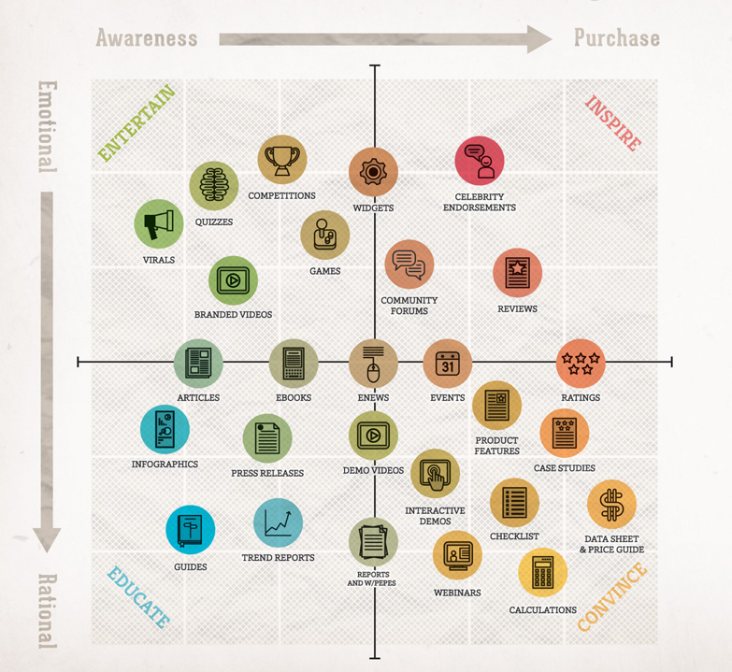
Press Releases
Videos
Podcasts
Brochures
Pictures
Traditional Ads
Email Campaigns
Speech Writing
Notes:
[Rafa & Joey] So then what is content? Content is anything. It’s articles, blogs, videos, websites, apps – it’s information. Some information is more useful than others depending on the audience. For example, a 2,000 word article might be a bit too in the weeds for a design engineer that is just looking for technical specs. But a lawyer will likely read every word. That’s why the first step in content strategy is…

Slide 20
Content Strategy Definition
Notes:
[Rafa] Content strategy is the creation, distribution, and measurement of content. It means making content, knowing where to send it and who to send it to, then measuring it to see if it was effective.

Slide 21
Step 1: Define Your Customer
Notes:
[Rafa] Defining your customer.

Slide 22
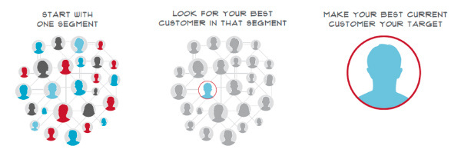
Notes:
[Rafa] When you’re defining your customer, don’t overwhelm yourself in the minutia.
Start with one segment of your business, look for the best customer in that segment. That’s you target customer. Now think about that customer. What information do they need? What questions do they have? Where do they source? What is their selection criteria? Why are they online in the first place?

Slide 23

Lost
Notes:
[Rafa] They go online when they’re lost. They want to find a PDF, a news article, a blog, something that will answer their question. Chances are, if there’s a question your customers always ask you over the phone, they’re asking the same question to Google. When your website has the answer in a piece of content, Google will send that customer to you. So how do you find out these questions?

Slide 24

They’re lost.
Help them.
Ask your customers
Notes:
[Rafa] Ask your customers. Pick 5 of them. 5 customers that match the profile of your target customer will likely have the same questions as 100 customers. Set up short, 15 minute interviews and find out what they want to know. Maybe you already have useful content they use. Great. Maybe they go to a competitor to find specific content. That’s useful information too. Next step…

Slide 25
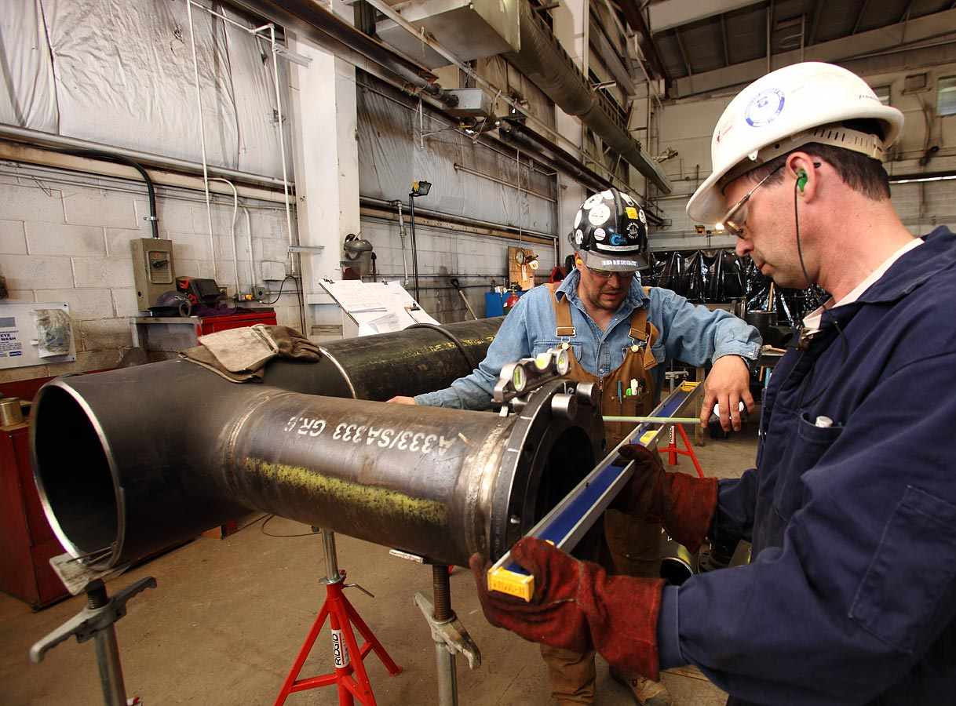
They’re lost.
Help them.
Call your customers
Talk to your engineers
Notes:
[Rafa] The guys designing your products are going to have insight that no one else at your company has. There may be a new technology they’re using that means nothing to you but means everything to a design engineer sourcing for a solution. Once you’re done talking to your engineers…

Slide 26

They’re lost.
Help them.
Call your customers
Talk to your engineers
Spy on competitors
Notes:
[Rafa] Channel your inner James Bond and spy on your competitors. Join their email list. Follow them on LinkedIn. See which competitor comes up in Google when you type your products or services. Find out what these guys are doing and if you should be doing it too. Next…

Slide 27
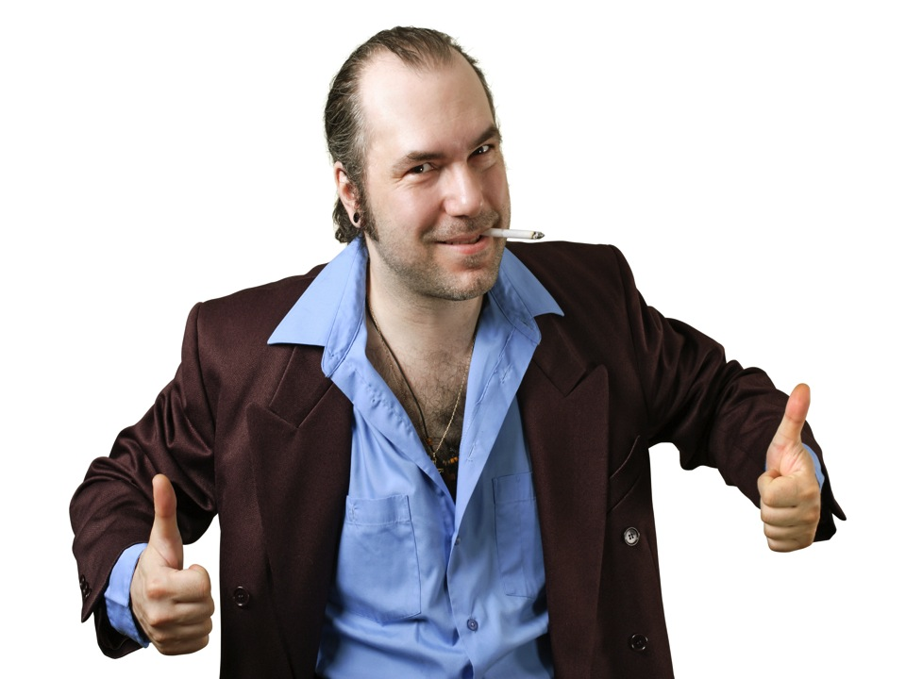
They’re lost.
Help them.
Call your customers
Talk to your engineers
Spy on competitors
Talk to Sales
Notes:
[Rafa] Talk to your sales guys. These are the guys fielding customer questions everyday. You should also ask them if there’s any content you should be producing that can help them close. Sell sheets, case studies, whatever they think customers want.

Slide 28

The MRO Facility Manager
Hank Miller
Engineering Manager
Age: 46
Company: $110 million utility plant
Cares About
Price Sensitivity
Motivations
Price, speed, reliable service
Healthy supplier relationships
Improving emergency response time
Goals
Identify and correct inefficiencies
Reduce on-hand inventories
Find suppliers that are quick to respond
Pain points
Has been burned in the past by cheaper suppliers that miss deadlines and ship defects
Prefers to work with a single person that truly understands the direness of Hank’s situation
With corrective maintenance, every minute his equipment is down, he’s losing money
With preventative maintenance, Hank wants to know the products he buys are durable and of high quality
Response Time
Engineering Capabilities
Supplier Relationship
Value Added Services
“I care about price, speed, and reliable service.”
Hank is under constant pressure to make the most of every supplier. He’s worked with the same tubing suppliers for years, but he’s frustrated that his existing suppliers don’t provide the value added services, such as warehousing, that will help him reduce his inventories and cut costs.
.
Common Questions
“How can you save me money?”
“How quickly do you respond?”
“How much is it gonna cost me?”
“How quick are your turnarounds?”
“What kind of experience do you have in my industry?”
Notes:
[Rafa] Once you’re done talking to these people, build a persona. A persona is a fictional representation of your target customer. You want to document your customer’s pain points, the common questions they’re asking, what motivates them to buy. This is valuable information that will guide what types of content you should produce.

Slide 29
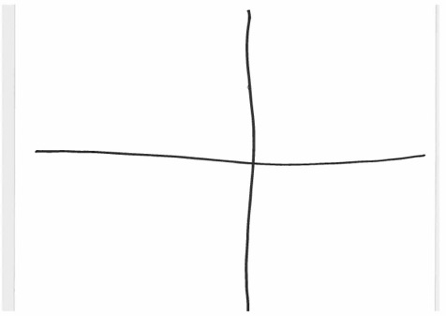
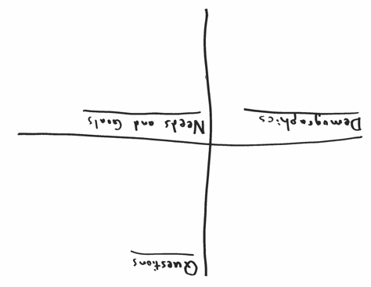
Notes:
[Rafa] Exercise #1. Let’s go through an exercise to define your customer. You should have a sheet of paper and a pen. Divide your paper into quadrants. In the bottom left is where we’re going to put demographical information about your customer. Top right is common questions this customer asks. Bottom right is what this customer is trying to accomplish – their needs and goals. In the top left, you’re going to put a face to your customer using your artistic abilities.

Slide 30
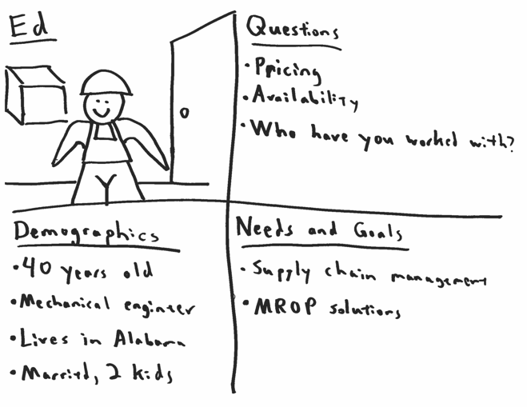
Notes:
[Rafa] Exercise #1 Let’s look at an example. This is Ed. He’s a 40 year old mechanical engineer that lives in Alabama with his wife and two kids. Ed cares about price, availability, and wants to know if you’ve worked with someone like him. For him, success is a successful supply chain and the availability of MRO products.
Take 5 minutes and create your customer. Then we’ll discuss a few of your examples.

Slide 31
Step 2: Manufacture Content
Notes:
[Rafa] Ok, now that you know your customers, let’s talk about making the content. Content creation is very similar to the manufacturing process.

Slide 32
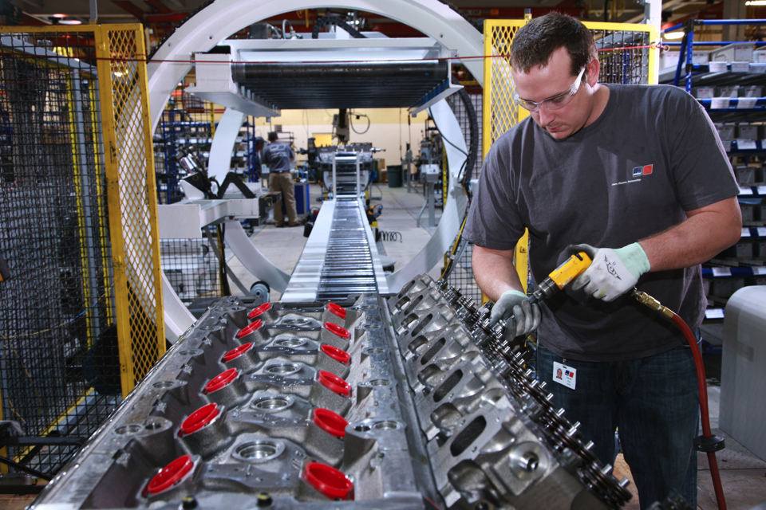
They’re lost.
Help them.
Call your customers
Final Assembly
Notes:
[Rafa] First, you want to create a big piece of content. This is a white paper, a case study, whatever you think is going to be helpful to your customers. A lot of content marketing plans fall apart because people don’t take the time or apply the production values necessary to make a good piece of content. It has to be so good that customers will give up their anonymity, their email address, to download it. It has to be so good that customers will share it with people in their network.
It takes times. It takes research. But it’s going to pay off because from this big piece of content…

Slide 33
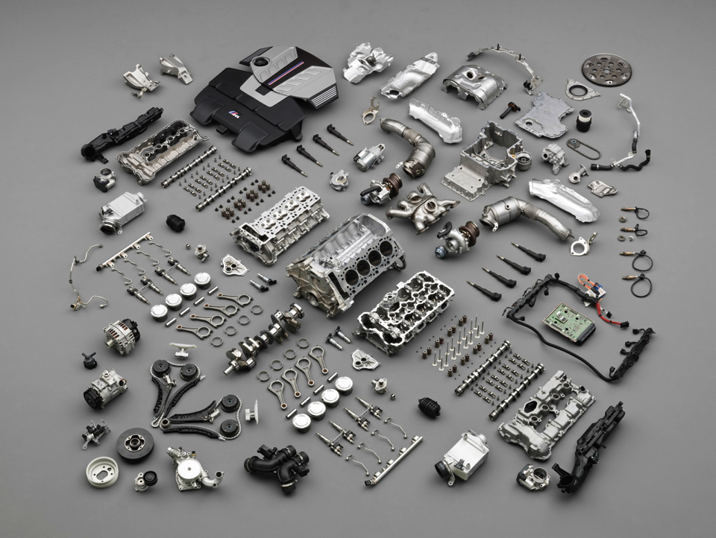
They’re lost.
Help them.
Call your customers
Big Piece of Content
Components
Notes:
[Rafa] You can create lots of little pieces. Blogs. Press releases. Social media updates. Small snippets of content that are easy to digest. These little pieces are designed to promote the big piece.

Slide 34
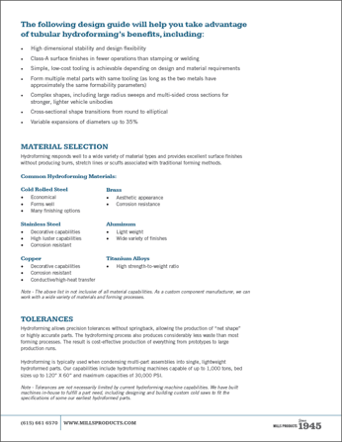
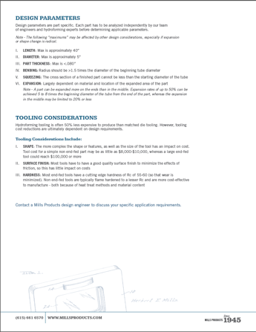

Notes:
[Rafa] Here’s an example of a hydroforming guide we created for a metalforming company, Mills Products. Mills told us that most of their customers were unfamiliar with the design considerations of hydroforming. Customers wanted to know tolerances and shapes you can make with the hydroforming process. Remember, just because your customers may be experts in their fields, they may not be experts in your field.

Slide 35
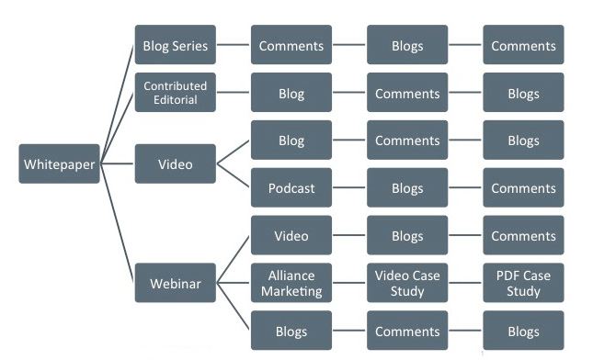
Notes:
[Rafa] From that hydroforming guide we were able to create small content. We repurposed it into multiple blog posts and shared smaller parts of it on social media.
Now let’s talk about blogs. Blogs get a bad rap. You hear blog and you think it’s about mommies talking about the best stroller or some Apple fanboy giving his predictions for the iPhone 8. Blogs are nothing more than educational articles. Every company should have one. It gives you a platform to publish articles as often as you want. Articles that answer your customers questions.

Slide 36
Write down 5 topics
Notes:
[Rafa] Exercise #2
Take a moment to write down 5 article topics. This could be 5 ideas for your big piece of content. It could be short blog articles. It’s whatever you think would interest your target customer.

Slide 37

They’re lost.
Help them.
Call your customers
Notes:
[Rafa] Let’s talk about AC/DC. It’s more than just a great band. It’s how you decide what content to create.

Slide 38
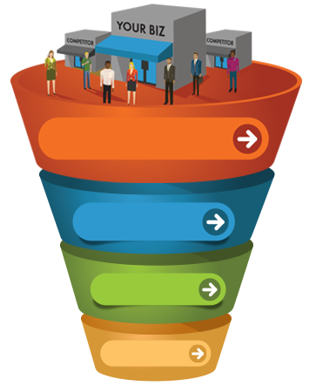
Recognize problem
Looking for solutions
General research
Awareness
Exploring possible solutions
Looking for testimonials
Creating a short list of possible providers
Want confidence they’re choosing the right provider
Credibility
Decision
Looking for ROI
Convert
Notes:
[Rafa] AC/DC is about targeting customers at every step of the buying process. Awareness. These are customers that recognize they have a problem and are looking for solutions. Maybe they don’t know the specifics of their problem and they’re just online doing general research. You may need content for those customers.
Then there are customers that know they need a solutions provider but they’re looking for credibility factors or information that will help them make a decision. They want to see content that will give them confidence they’re selecting the right partner.
Finally, there’s convert. This is content that gives customers a clear indicator of the ROI they can expect. This could be calculators. It could be pricing guides. Whatever content that helps the customer feel comfortable they’re getting an return on their investment.

Slide 39
AWARENESS: RECOMMENDED CONTENT
Social media
Blogs
Infographics
eBooks
Guides
Quizzes
Videos
Webinars
Notes:
[Rafa]

Slide 40
Credibility and Decision: RECOMMENDED CONTENT
Newsletters
Demos
Analyst Reports
Case Studies
Print Articles
Testimonials
Press Releases
Widgets
Calculators
White Papers
Notes:
[Rafa]

Slide 41
Convert: RECOMMENDED CONTENT
In-person events
ROI calculators
Pricing guides
Product samples
Notes:
[Rafa]

Slide 42
ASK YOURSELF
Why are we developing this content?
What do we have to work with?
Who is our audience and what information do they need?
What is the best format for information?
How much time do we have?
How will we measure the success of our content?
Notes:
[Rafa]

Slide 43
ProcessBarron
Notes:
[Rafael] This is a company that provides engineering solutions and repairs for all parts of an industrial boiler system, from the conveyors that put fuel into the system to the ash handling systems that process burnt fuel. The problem was, most people only know processbarron for fans. They make great fans – have been making them for years. Plant managers call them for a fan repair, ProcessBarron goes out to the field, and while they’re find a dozen other ways they can help the plant improve efficiency. We thought it would be great if we could provide content that help not just plant managers that want information on fans, but plant managers that are searching for all types of efficiency improvements.
We created a learning center on ProcessBarrons website. Case studies, white papers, articles – valuable content that saves plant managers money. This content is free if you give your email address. Customer gets great content, we get an email address. Maybe that customer didn’t buy that day, but now we can continue to send newsletters and new articles to this customer – keeping us top of mind when the customer is finally ready to buy. The result was taking processbarron from a 70 million dollar business to a 110 million dollar business.
Ok, so we know what to make. Now what do we do with it?

Slide 44
Step 3: Distribution
Notes:
[Joey] So, now you’ve created this fantasitc piece of content. It’s thought-provoking, helpful and solidifies your company as a thought leader in the field. Now, how in the world do you get it to the people that you’ve already targeted that need to read it?

Slide 45
Distribution
Search Engine Optimization (SEO)
Public Relations
Social Media
Advertising
Email
Notes:
[Joey]

Slide 46
Search engine optimization
Search Engine Optimization
The process of maximizing the number of visitors to a particular website by ensuring that the site appears high on the list of results returned by a search engine.
Notes:
[Joey] “…” ‘’’so, what does that mean and how is it put into practice?

Slide 47
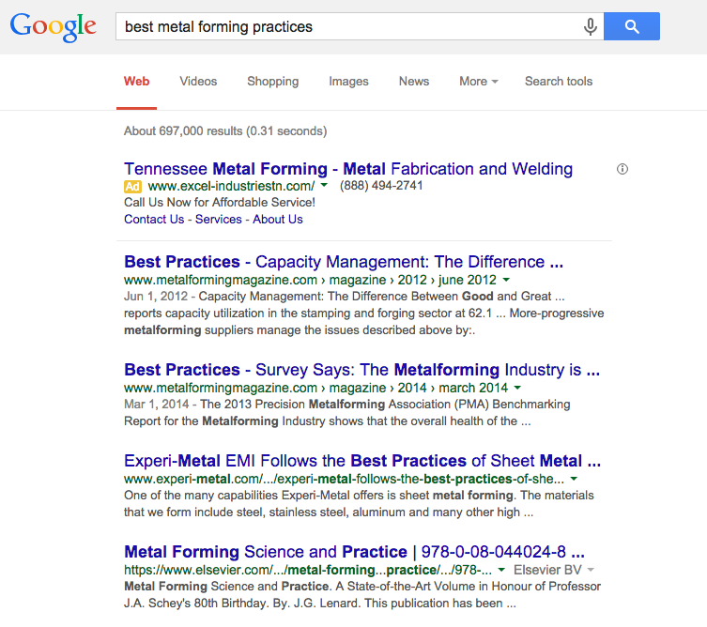
Search engine optimization
Notes:
[Joey] Search engine optimization is a lot like a puzzle. There are a lot of pieces available to you to use, but you need to make sure they are used in the right way and correct order to truly see the picture you’re trying to create.
In a nutshell, Search Engine Optimization is all about helping your website show up here (click) instead of down here (click).
Just to put it a little more in perspective for you, 95% of online searchers never make it to page two of search results. The first three spots in a good search result get 61.5% of all traffic.

Slide 48
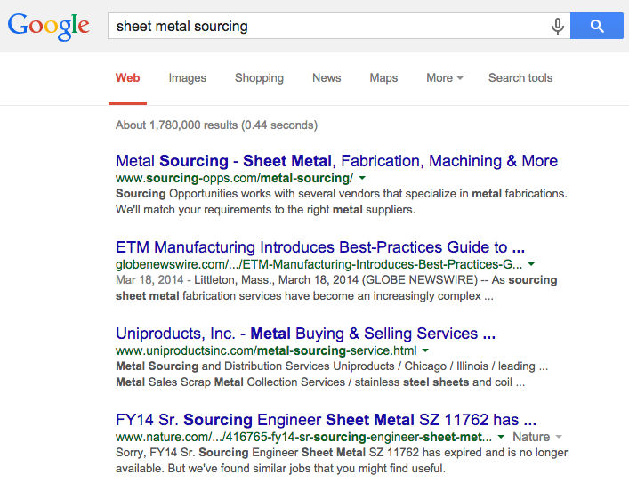
Search engine optimization
Page
Title
URL
Meta
Description
Notes:
[Joey] Google keeps the algorithms that control how pages rank pretty close to the chest, but SEOs have figures out a lot of what’s important.
Three of the main areas of importance to us are Page Titles, URL structure and Meta Data.
[Define and show each]

Slide 49
Search engine optimization
Notes:
[Joey] Why is all that important? Well, I’m sure you’ve heard the term “Keyword” or “Keyword Phrase” before. Google makes their money by making sure that the pages that show up for people are actually what they want to see, so Google is looking for indicators that your site has the content people want.
The only way Google knows what people want is by the actual terms the type into search engines. These are “Keywords” and “Keyword Phrases.” Google looks for ways to match those requests up to what is on your page. (Click)
So, it’s very important you have those phrases your potential customers want to find on your site so Google knows to show your page when they are searched.

Slide 50
Public relations
Public Relations
The professional maintenance of a favorable public image by a company or other organization; the state of the relationship between the public and a company or other organization.
Notes:
[Joey]

Slide 51
Public relations
Press Releases
Press Conferences
Media Alerts
Media Relations
Special Events
Notes:
[Joey] There are five main avenues for Public Relations activities. Most of these will require a dedicated media team internally or through an agency, so I’ll make sure to highlight the ones that are helpful for our purposes today.

Slide 52






Social media
Notes:
[Joey]

Slide 53
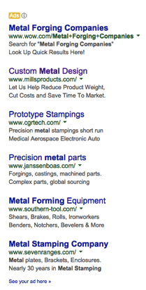



advertising
Text Ads
Banner Ads
Remarketing
Notes:
[Joey]

Slide 54
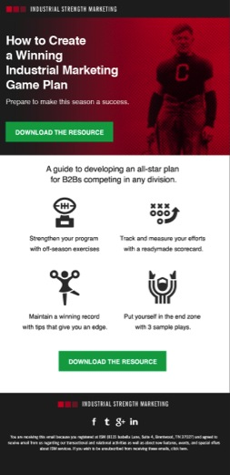
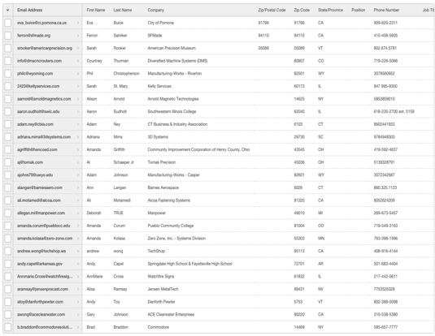
email
Notes:
[Joey]

Slide 55
Step 4: Measure
Notes:
[Joey] Now that we’ve created a great piece of content and we know where and how we’ll be distributing it, we’re not done. There is still the little matter of making sure you were successful.

Slide 56
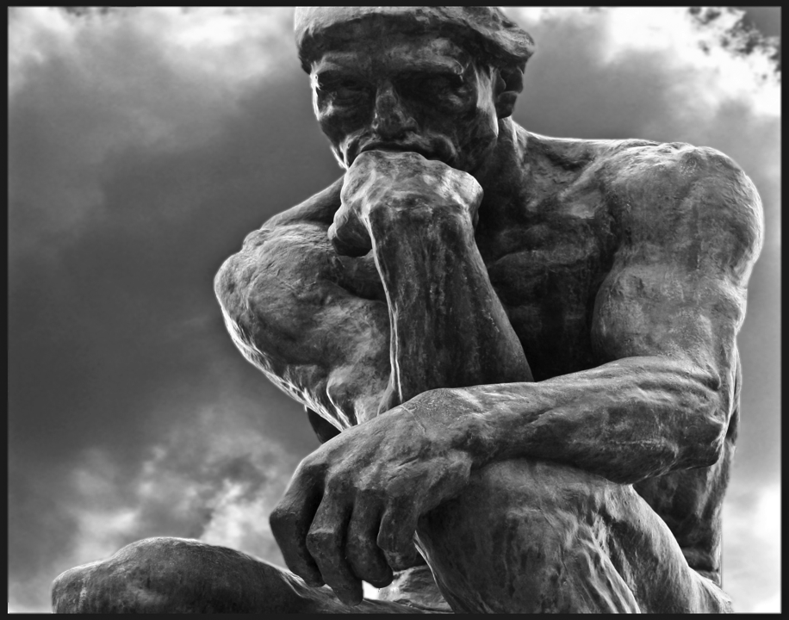
Why Measure
Notes:
[Joey]

Slide 57
Step 1: Why Measure
Know how/why to update
Calculate ROI
Justify activity
New content ideas
Notes:
[Joey]

Slide 58
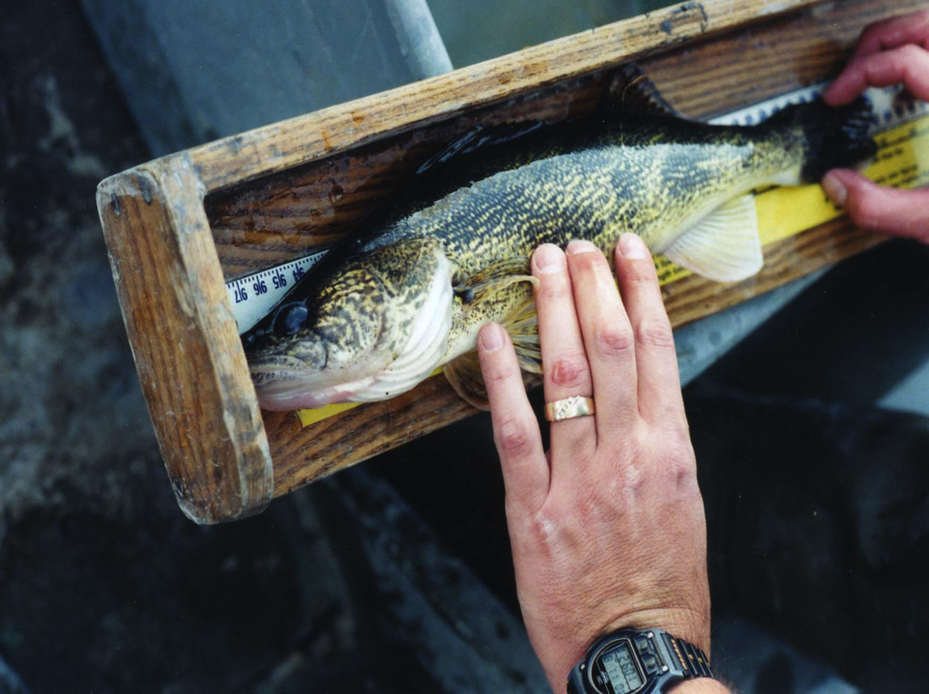
How to Measure
Notes:
[Joey]

Slide 59
Step 2: How to measure
Know your content’s purpose
Choose KPIs (Key Performance Indicators)
Set goals
Be flexible
Notes:
[Joey]

Slide 60
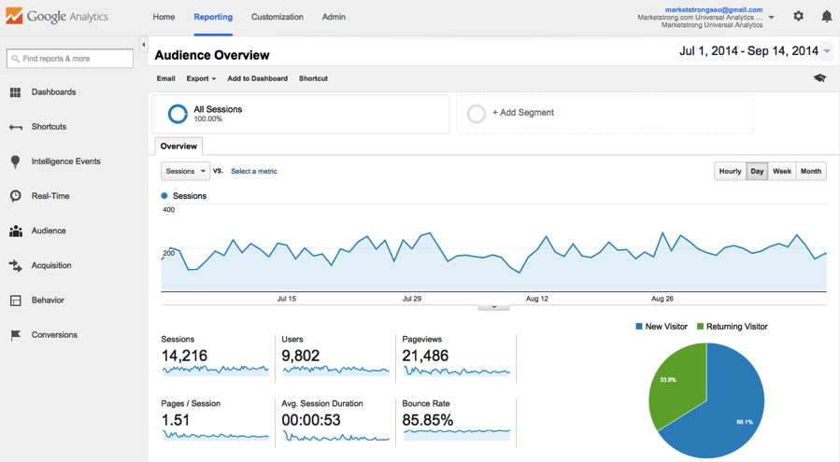
Step 2: How to measure
Google Analytics
Notes:
[Joey]
Google Analytics is our preferred and recommended program for following and setting data for measurement purposes. This is a free tool Google provides for this very purpose, so there’s no reason not to get it up and running on your websites if you haven’t already.
It’ll show you:
The traffic flow for your site (click)
Data broken out by source and method of contact and even tracks goals you set (click)
You can set specific date ranges and compare current performance to past performance, etc (click)
And even breaks down the numbers further to show you how long people stayed on your site and how many pages they looked at (click)
I’m sure many of you are familiar with this dashboard, but truly understanding and using analytics for the purposes of your content marketing will be one of, if not the most, important step you’ll take in this whole process.

Slide 61

Adapt
Notes:
[Joey] Now, life happens. So one of the most important aspects of using analytics and data is to understand how and when to adapt and update your plans.

Slide 62
Step 3: adapt
Update editorial calendar
Stay on top of news
Targeting updates
Notes:
[Joey]
What types of updates are we talking about?
No, you shouldn’t abandon your overall strategy or targets after only a few weeks of data, but there are changes you can make within your plan that can have really positive results.
Just because you CAN measure every day and every hour, doesn’t mean that you NEED to or that it will be helpful.

Slide 63

Questions?
Notes:
[Joey & Rafa]
We’d like to take these last moments of this session and use the time we have left to answer your questions and open up the floor for a Q&A.

Slide 64

T.Hanks!

